Slide 1
RUNGTA COLLEGE OF DENTAL SCIENCES AND RESEARCH
EPILEPSY
DEPARTMENT OF GENERAL MEDICINE

Slide 2
SPECIFIC LEARNING OBJECTIVES
NICE TO KNOW
DESIRE TO KNOW
MUST KNOW
WHAT IS EPILEPSY
TYPES
CAUSES
MANAGEMENT
STATUS EPILEPTICUS
INTRODUCTION
PROGNOSIS

Slide 3
CONTENTS
WHAT IS EPILEPSY?
CAUSES
TYPES
MEDICAL MANAGEMENT
SURGICAL MANAGEMENT
PROGNOSIS
STATUS EPILEPTICUS
SUMMARY

Slide 7
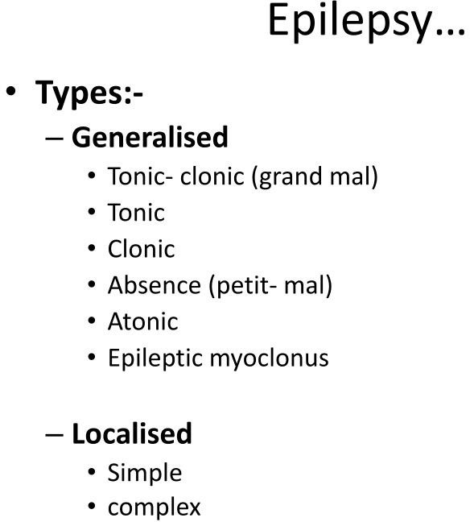

Slide 8
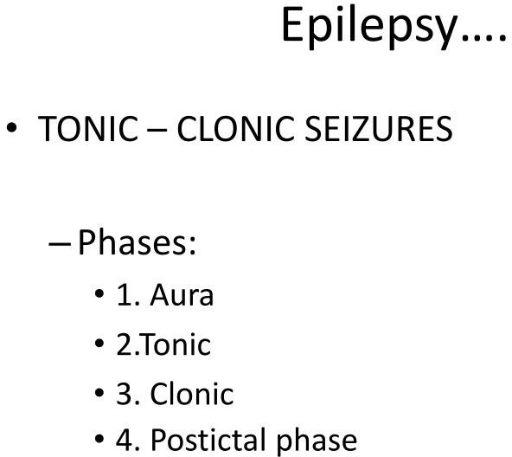

Slide 12
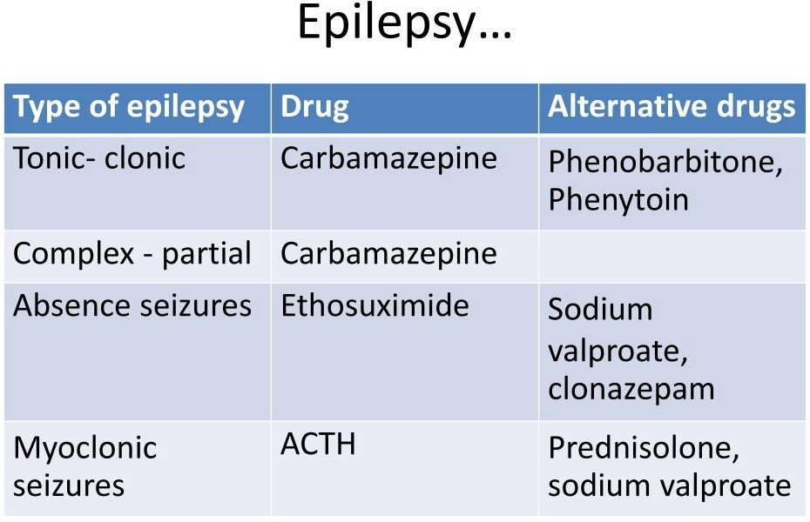

Slide 13
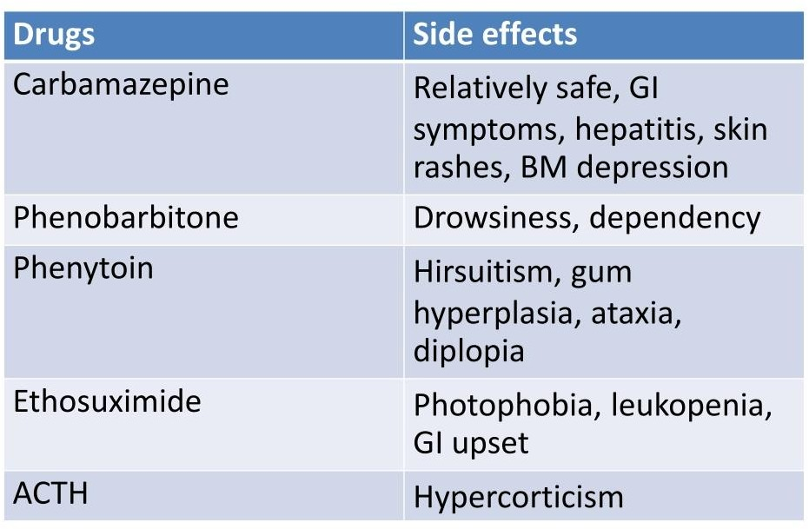

Slide 27
SUMMARY
Epilepsy is the tendency to have unprovoked seizures.
The lifetime risk of an isolated seizure is about 5%, although incidence is highest at the extremes of age.
Epilepsy is the tendency to have unprovoked seizures.
While the prevalence of active epilepsy in European countries is about 0.5%, the figure in developing countries may be higher because of parasitic illnesses such as cysticercosis.
It is important to explain the nature and cause of seizures to patients and their relatives, and to instruct relatives in the first aid management of seizure.

Slide 28
REFERENCES
DAVIDSON’S PRINCIPLES AND PRACTICE OF MEDICINE; 23rd edition
HARRISON’S PRINCIPLE OF INTERNAL MEDICINE; 21ST edition
TEXTBOOK OF CLINICAL MEDICINE by S.N Chugh ;5th edition

Slide 29
Any questions?

Slide 30
Thank you

